Slide 1
Aquaponics
System
Anna Mesas Llaurado - n⁰1130896
Arlene Docherty - n⁰1131590
Gwenael Mery - n⁰1131572
Natalia Sokolowska – n⁰1131614
Sean Keane - n⁰1130941
Team 5
Aquaponics System
EPS@ISEP – Spring 2014

Slide 2
Introduction
Problem
Objective
Motivation
Different Options – State of the Art
Marketing
Design – Product Development
Operation and Materials
Ethical and Deontological Concerns
Sustainability
Conclusions – Where we are now
Questions
Team 5
Aquaponics System
Summary
EPS@ISEP – Spring 2014

Slide 3
Problem
To design and build a system without the use of soil and supported by water recirculation.
Must be as sustainable as possible.
Objective
To create a working system to support both fish and plant culture.
Monitor parameters in the system.
Budget of €250
Motivation
To create a very sustainable, eco-friendly product.
To design our own unique product.
Team 5
Aquaponics System
Introduction
EPS@ISEP – Spring 2014

Slide 4
Plant Harvest
Fish excrete Ammonia
Fish Harvest
Nitrosomonas sp. Converts Ammonia to Nitrites
Plants absorb Nitrates
Nitrobacter sp. Converts Nitrites to Nitrates
Team 5
Aquaponics System
System
EPS@ISEP – Spring 2014

Slide 5
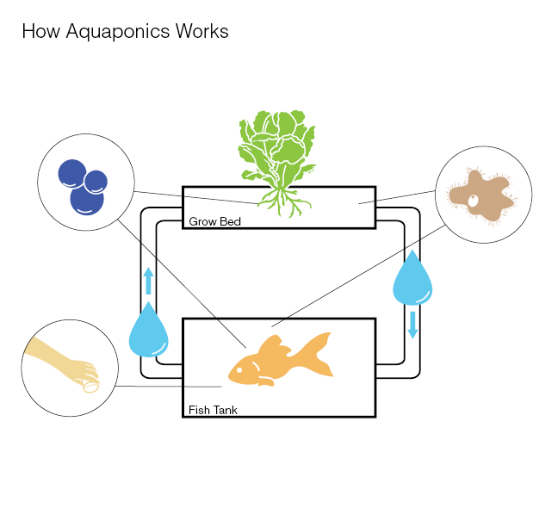
1 - Water circulation
2 - Grow Bed
Continuous flow
Flood and drain
Chift pist
Nutrient film technique
Deep water culture
Media filled beds
2
1
Fig. 1
Team 5
Aquaponics System
State of the Art
EPS@ISEP – Spring 2014

Slide 6
Back to the Roots
Backyard Aquaponics
Nelson Pade’s Shop
Fig. 2
Fig. 3
Fig. 4
Team 5
Aquaponics System
Competitors
EPS@ISEP – Spring 2014

Slide 7
SWOT
Strengths
Weaknesses
Eco-friendly
Herbs cheaper than in store
No reputation on the market
Limited budget and time
Design can become unfashionable quickly
Decorative modern design
Opportunities
Obtaining EU funding and further development
Introducing our prototype to the new markets outside Europe
Threats
Copying (or improving) our prototype by bigger companies
Launching of worldwide shipping by our competitors
Team 5
Aquaponics System
SWOT Analysis
EPS@ISEP – Spring 2014

Slide 8
Household appliance that makes cooking easier
Modern luxury gadget
Team 5
Aquaponics System
Approaches
EPS@ISEP – Spring 2014

Slide 9
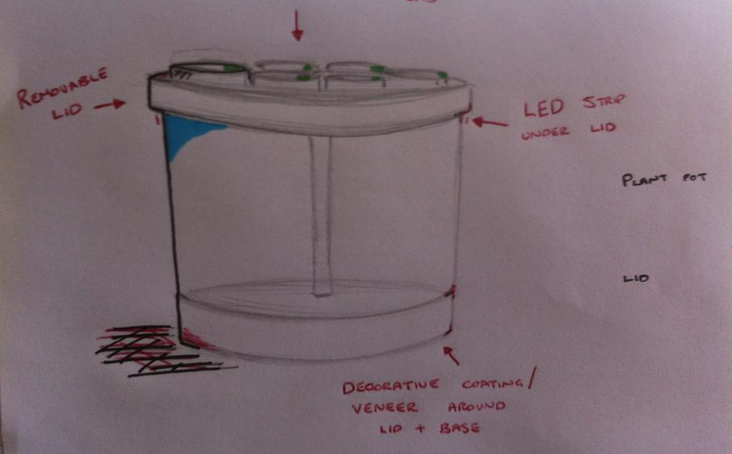
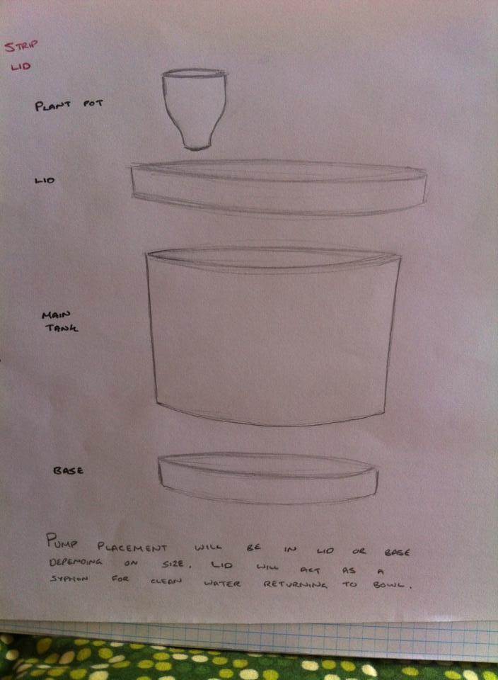
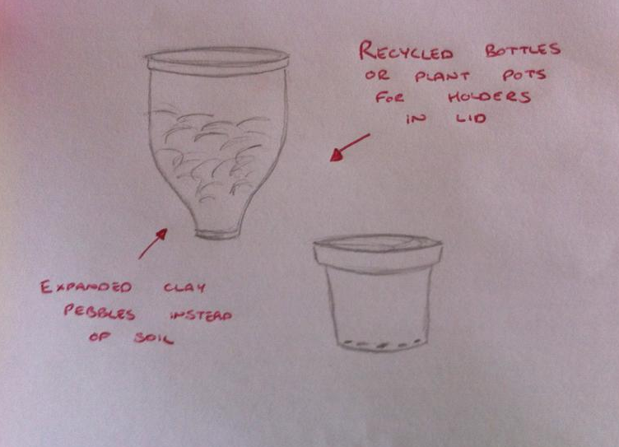
Simple
Aesthetic
Sleek
Modern
Centre-Piece
Team 5
Aquaponics System
Initial Design
EPS@ISEP – Spring 2014

Slide 10
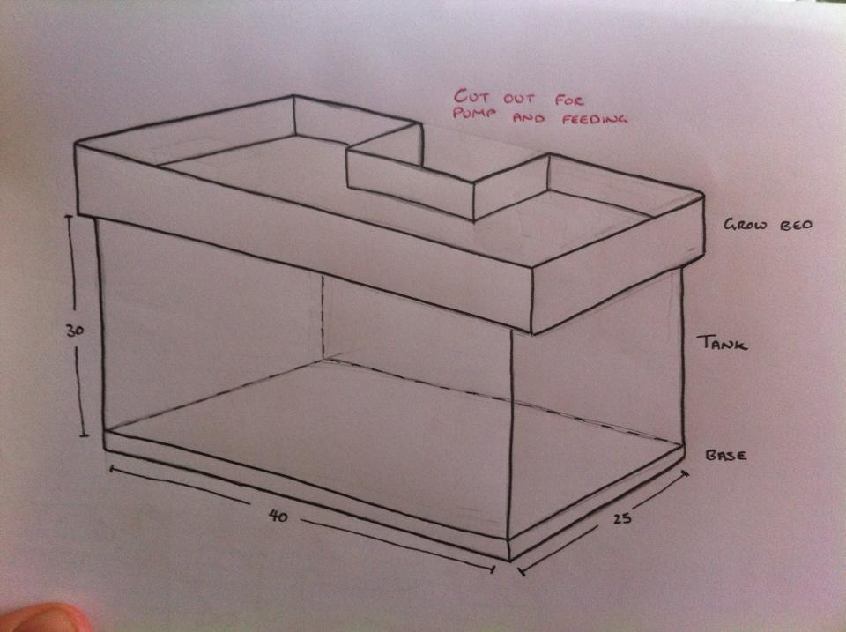
Grow Bed
Tank
Dimensions: H300, W250, L400
Unethical
Larger Tank
Easier Access
Simple Manufacture
Font for body.
Team 5
Aquaponics System
Design Development
EPS@ISEP – Spring 2014
10

Slide 11
What ?
How ?
Why ?
Honesty
Responsibility
Confidence
What ?
Justice
Respect
Why ?
Quality of Life
Community
Profession
How ?
Client/Employer
Colleagues
Fig. 5
Font for body.
Team 5
Aquaponics System
Ethics + Deontology
EPS@ISEP – Spring 2014
11

Slide 12
Academics
Marketing
Fig. 6
Fig. 7
Liability
Environmental
Fig. 8
Fig. 9
Fig. 10
Team 5
Aquaponics System
Ethics + Deontology
EPS@ISEP – Spring 2014
12

Slide 13
Three Spheres of Sustainability
Environmental
Viable
Bearable
Economic
Social
Equitable
Team 5
Aquaponics System
Sustainability
EPS@ISEP – Spring 2014

Slide 14
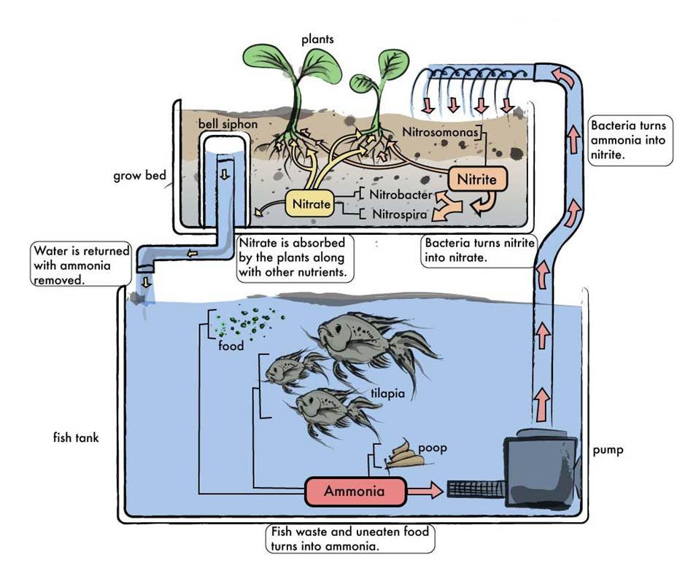
Fig. 11
Team 5
Aquaponics System
Our System
EPS@ISEP – Spring 2014

Slide 15
Component | Description | Company | Quantity | Price
Microcontroller | Arduino Due Model:ARDU-00328 | InMotion | 1 | 37
Temperature Sensor | Waterproof (DS18B20) Model:INM-0494 | InMotion | 1 | 8.95
pH Sensor | ASP200-2-1M-BNC pH Lab Electrode | InMotion | 1 | 26.95
LCD Screen | Arduino TFT LCD Screen | InMotion | 1 | 19
LED Lights | Addressable RGB 30-LED Strip 5V 1m, | InMotion | 1 | 17.95
Water Pump | Syncra Silent 0.5 Multifunction Pump | Sicce | 1 | -
Fish | Amatitlania nigrofasciata (Convict cichlid) | N/A | 4 | -
Pipes | Acrylic connecting pipes to water pump | Dagol | 1
Grow Bed | Plastic trays | Dagol | 1
Clay Pebbles | Expanding clay pebbles | Leroy Merlin | 2kg | 1
Herbs | Basil, Rosemary and Thyme | Bolhao Market | 2 | 5
Fish Food | Regular fish flakes | Jumbo | 1 | 3.19
Tank | Small tank 40x20x35 | Jumbo | 1 | 44.9
Sand/Rocks | Small rocks for base of aquarium | Jumbo | 1 | 7.99
pH Adjusting Solution | Solution for adjusting the water pH level | Zoofeira | 1 | 8
Team 5
Aquaponics System
Materials
EPS@ISEP – Spring 2014

Slide 16
Achievements
Design and material list finalised
Good background knowledge about all areas of aquaponic systems
Decided on suitable market area and developed plan
Considered possibilities to apply sustainability in our project
Future Developments
Buy all components
Create precise drawings on computer software
Combine all the components and build the prototype
Do all necessary tests
Team 5
Aquaponics System
Conclusions
EPS@ISEP – Spring 2014

Slide 17
Thanks for Listening!
Any Questions ?
Aquaponics
System
Team 5
Aquaponics System
EPS@ISEP – Spring 2014

Slide 18
Figure N⁰ - Link
http://aquaponicsplan.com/aquaponics-systems-at-home-recreating-the-mother-nature-in-your-backyard/
https://www.backtotheroots.com/shop/aquafarm
http://backyardaquaponicsshop.com/
http://aquaponics.com/
http://www.revestida.com/tag/salud-mental
http://www.otis.edu/library/copyright-fair-use-guidelines
http://www.preparednesspro.com/are-you-part-of-the-problem
http://www.gehnastore.com/cms.php?id_cms=14-Guarantee-Gehna-Online%20JewelryStore
http://s402.photobucket.com/user/sealhuntdfocanada/media/Animals-Hands-Holding-Green-Earth.jpg.html
http://www.pinterest.com/huhuwaiting4u/pins/
http://ablogaboutnothinginparticular.com/wp-content/uploads/2014/01/DIY-Aquaponics.jpg
Team 5
Aquaponics System
Bibliography
EPS@ISEP – Spring 2014

