Slide 1
Aquaponics
System
Team PHIVE:
Anna Mesas Llaurado - n⁰1130896
Arlene Docherty - n⁰1131590
Gwenael Mery - n⁰1131572
Natalia Sokolowska – n⁰1131614
Sean Keane - n⁰1130941
Team 5
Aquaponics System
1
EPS@ISEP – Spring 2014

Slide 2
Introduction
- Problem, Objective, Motivation
System
- Components
Electronics
Project Development
Marketing
Conclusions
Video
Summary
Team 5
Aquaponics System
2
EPS@ISEP – Spring 2014

Slide 3
Problem
To design and build a system without the use of soil and supported by water recirculation.
Must be as sustainable as possible.
Objective
To create a working system to support both fish and plant culture.
Monitor parameters in the system.
Budget of €250
Motivation
To create a very sustainable, eco-friendly product.
To design our own unique product.
Introduction
Team 5
Aquaponics System
3
EPS@ISEP – Spring 2014

Slide 4
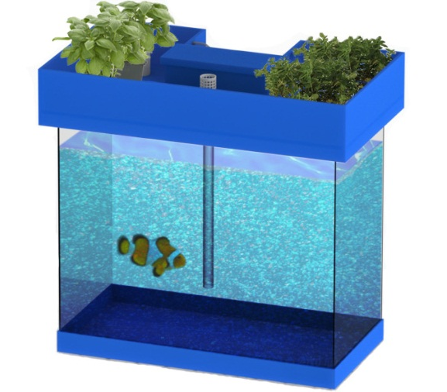
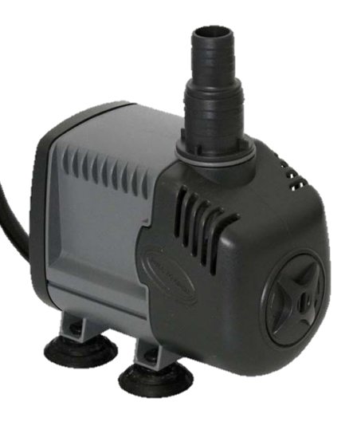
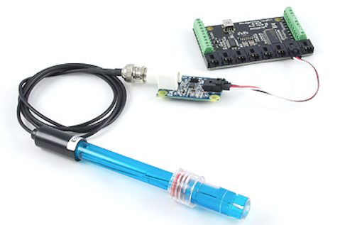
System
Team 5
Aquaponics System
4
EPS@ISEP – Spring 2014

Slide 5
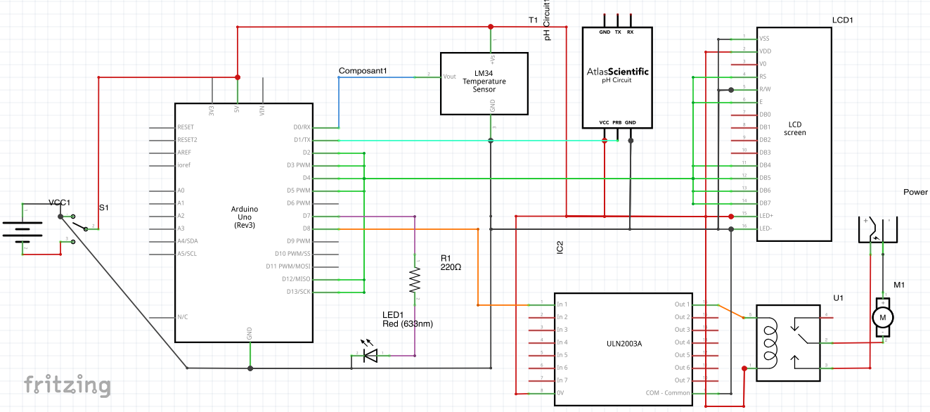
Electronics
Team 5
Aquaponics System
5
EPS@ISEP – Spring 2014

Slide 6
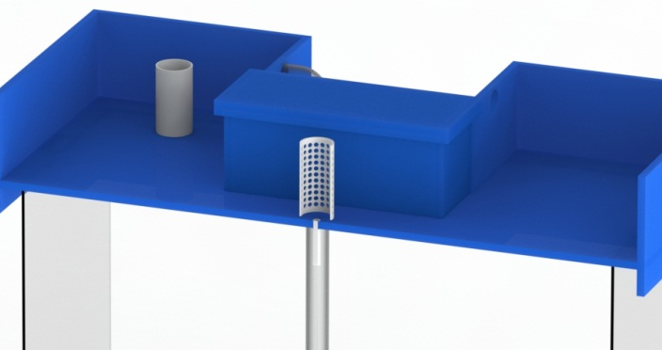
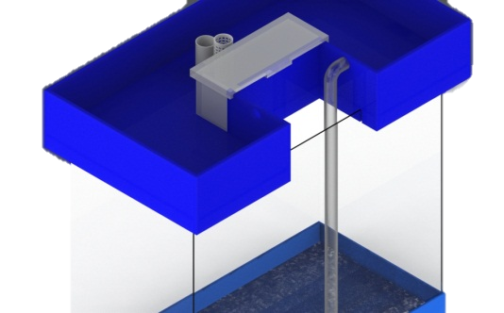
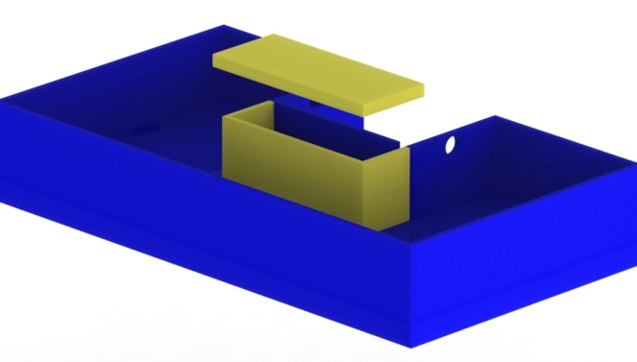
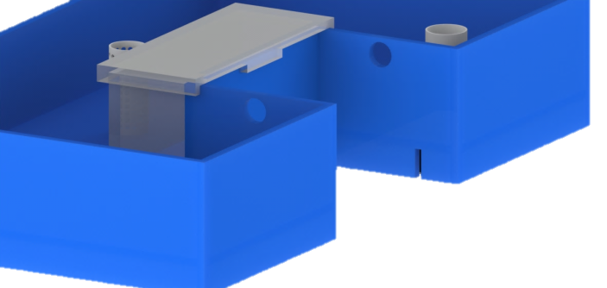
Grow Bed
Project Development
Team 5
Aquaponics System
6
EPS@ISEP – Spring 2014

Slide 7
Target
One major competitor.
Large market share available.
Organic food unable to cope with demand.
Location
No large competitors in Europe.
Will be considered a new and fresh idea.
Management
Offer guarantees to customers.
Establish a brand and loyal customers.
Sustainable future developments.
Marketing
Team 5
Aquaponics System
7
EPS@ISEP – Spring 2014

Slide 8
Achievements
Final Rendered CAD Drawings.
Successful Electronic testing.
Under Budget.
Developed a product specific marketing plan.
Obtained new knowledge and skills.
Future Developments
Creating a cheaper overall product
Entirely recycled materials
Used within Third World countries.
Development of an Online Website/Shop.
Conclusions
Team 5
Aquaponics System
8
EPS@ISEP – Spring 2014

Slide 9
Video
Team 5
Aquaponics System
9
EPS@ISEP – Spring 2014

Slide 10
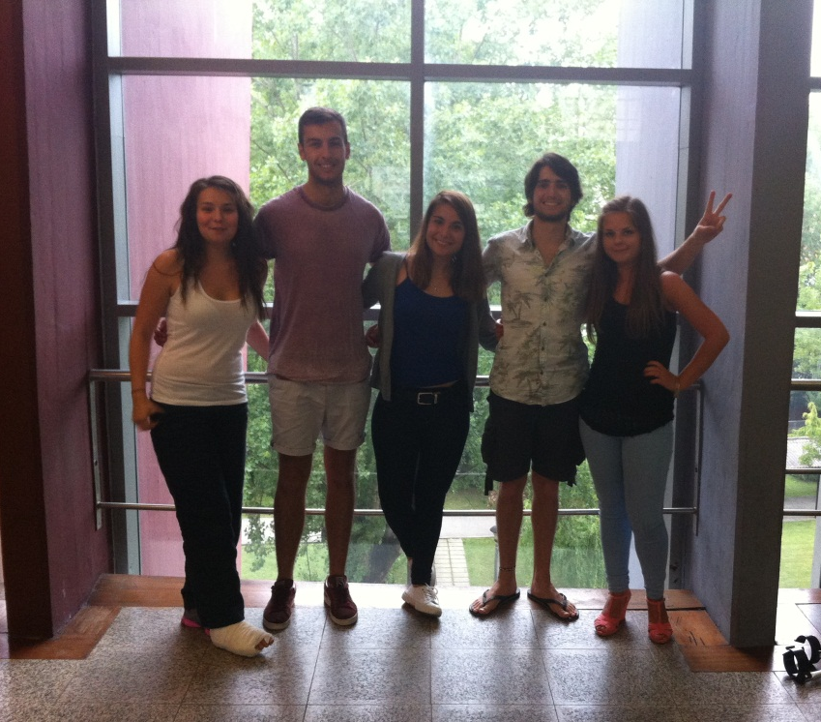
Thanks for Listening!
Any Questions ?
Aquaponics
System
Team 5
Aquaponics System
10
EPS@ISEP – Spring 2014

